Slide 1
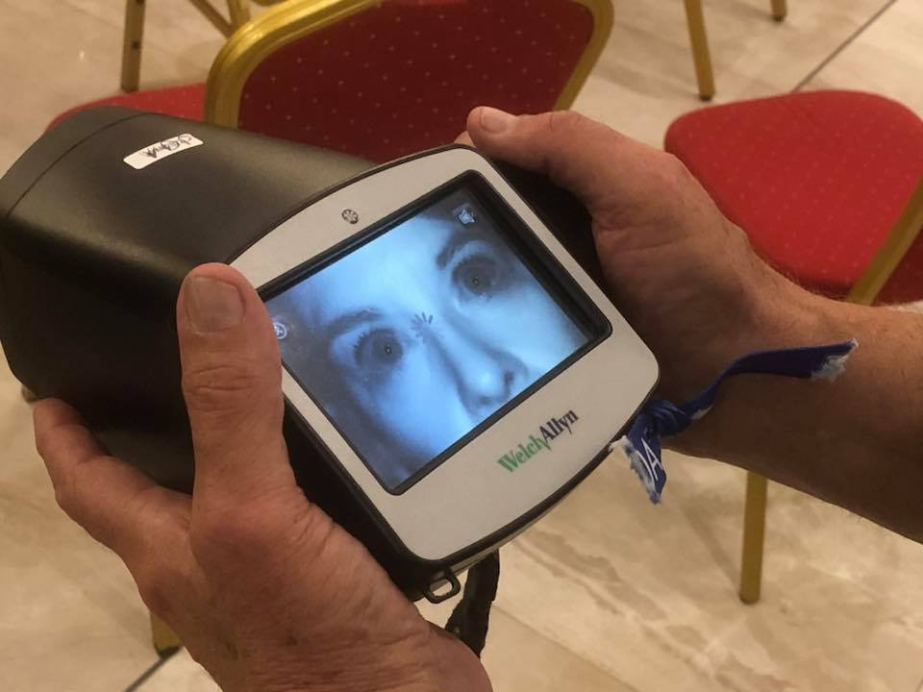
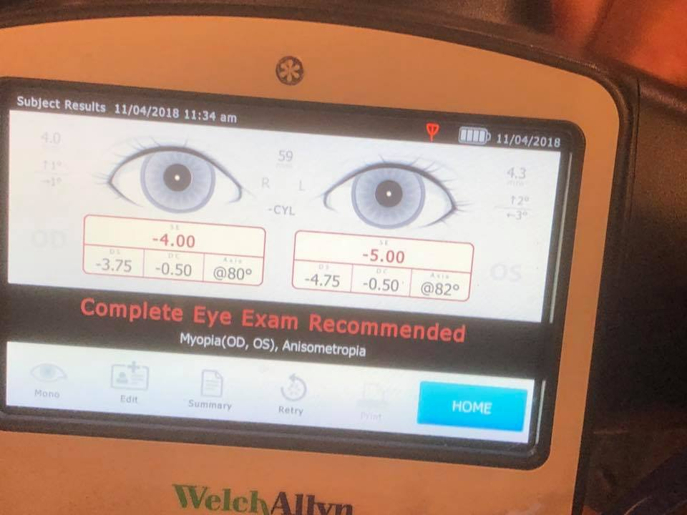
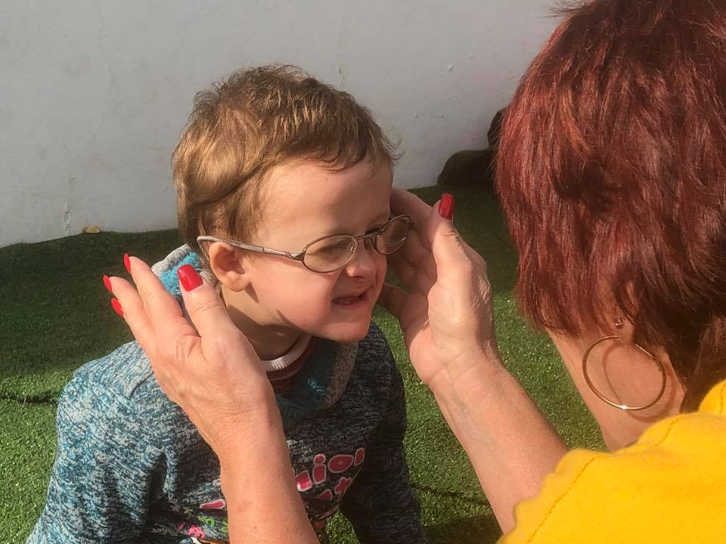
ChildSight UK – District CE Vision Screening Project Lion David Pope

Slide 2
Where There’s A Need, There’s A Lion
Vision
13% of all Children in the UK may have an undiagnosed common eye sight problem
Screening of School Children aged 4 to 5 years only happens in 55% of Local Education Authorities
Current screening is a practical assessment and does not look at the mechanics of the individual eye
Free optician run eye tests are available post Lions Screening to ensure that a formal diagnosis is in place

Slide 3
Where There’s A Need, There’s A Lion
Vision
MD105 has tasked Lions across the British Isles to continue being Knights of The Blind
The camera is a quick and easy way to screen a large number of young people in a short space of time
Each scan gives us one of two results Green or Red, this then allows Lions to give a Green or Red Letter to the young person’s parents
Both letters refer the parents to an optician – one for regular testing the other for a review in the following weeks

Slide 4
Where There’s A Need, There’s A Lion
Vision
Action Plan
Public Health England are currently look at approving our scheme (Key to getting into schools)
Training on the Camera Operators will roll out District by District once approval from PHE has been given
Every screening will follow the same procedure, every time, to ensure continuity of screening
Districts are currently raising funds to buy camera’s – some of these will be eligible for match funding from LCIF

Slide 5
Where There’s A Need, There’s A Lion
Vision
Test Pilot Areas
We identified three areas for a pilot of the cameras, Each event will have a survey to complete after by the Lions involved
Colchester – 276 Children Screened 25 Children referred to optician (9.1%)
Coventry – 84 Children Screened 8 Children referred to optician (9.5%)
Bournemouth – 310 Children Screened 40 Children referred to optician (12.9%)

Slide 6
Where There’s A Need, There’s A Lion
Vision
What Next
Fundraising for Cameras
Website goes live as soon as PHE approve project
Training for all districts
A Pin badge for the Knights of the Blind – for those who complete the training
Continue to work with District Camera Leads
Two way communication between DG, Leads & Project Management Team

Slide 7
Where There’s A Need, There’s A Lion
Vision
What Next
Currently applying pressure to PHE to get the Green Light
Hope to start getting into schools during the spring term in at least one district
Make a real difference to young peoples vision in the UK
#WESERVE #LionsVision

Slide 8
Thank You!
Vision
Notes:
(Thank the audience and mention these 3 points.)

