Slide 1
Carers Trust Supporting Young Carers
Notes:
Intro slide
Hi everyone,
Thank you so much for the opportunity for us to speak here today about Carers Trust and the work that we do, particularly with young carers.
Today we will be talking about the impact of caring and what it means to be a young carer. We hope you will understand better who young carers are, why it’s so important to support them and how you can help create brighter futures for them.
We will have time for a Q&A at the end, so feel free to ask any questions.

Slide 2
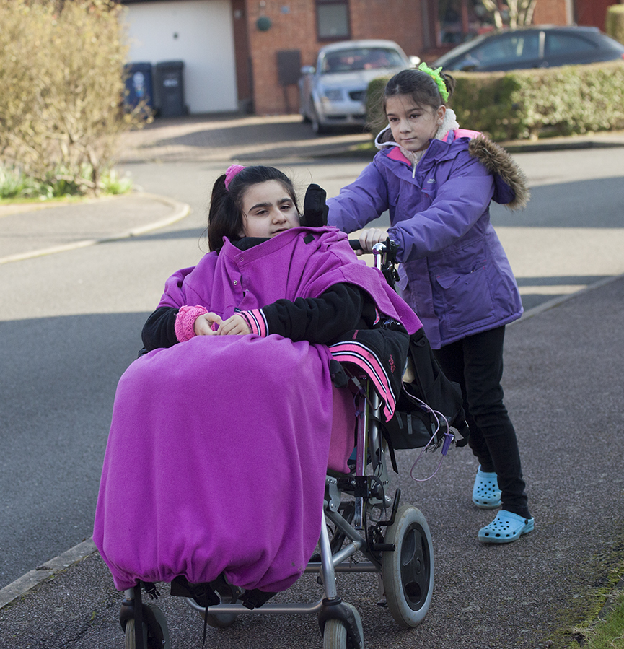
A carer is anyone who cares, unpaid, for a friend or family member who due to illness, disability, a mental health problem or an addiction, cannot cope without their support.
Young carers are children and young people aged 5-17 with caring responsibilities.
Notes:
Who are carers?
A carer is anyone who cares, unpaid, for a friend or family member who due to illness, disability, a mental health problem or an addiction, cannot cope without their support.
Young carers are young people aged between 5-17 with caring responsibilities.
There are over one million young people in the UK coping with the daily pressures of caring for a family member who cannot look after themselves.
Only half of young carers have a particular person in school who recognises that they are a carer and helps them. Imagine how many young people don’t make the connection between helping a loved one and being a young carer – or haven’t identified as one. Or how many more may have become young carers as a result of the pandemic.
Every young carer is unique and so is their caring role. Just some of what they might do in their caring role includes:
Practical tasks, such as cooking, housework and shopping.
Physical care, such as helping someone out of bed.
Emotional support, such as talking or listening to someone who is distressed.
Personal care.
Managing the family budget and collecting prescriptions.
Helping to give someone their medication.
Helping someone communicate.
Looking after brothers and sisters.
There can be so many different levels to their caring roles, which means that these young carers often develop the kind of knowledge and skills that many other young people their age may not have.

Slide 3
The impact of caring
Poor mental health
Impact on social life
Isolation & loneliness
Low self-confidence and aspirations
Less access to opportunities
Managing education and caring role
Strain on relationships
Notes:
The Impact of Caring:
For young people, caring can have a huge impact, particularly on the things that are important to growing up, that many of us may take for granted:
It can affect a young person’s health, social life, and self-confidence - 40% of young carers say their mental health is worse since Coronavirus and 67% of are more worried about the future.
It can be incredibly isolating, lonely and stressful. During the pandemic, this would have been exacerbated even more, with 66% of young carers feeling more stressed since Coronavirus.
Many struggle to manage their education and caring role which can cause pressure, stress and strain on their relationships.
On average, young carers have significantly lower educational attainment at GCSE level than their peers who do not have caring responsibilities.
Young carers miss or have cut short 48 school days every year because of their caring role.
68% of young carers are bullied in schools. And having a caring responsibility is one of the main characteristics of young people aged between 14 and 16 who have been bullied.
So, you can see how the caring roles that many young people have, affect so many different areas of their lives – including their education, mental health, relationships and aspirations. The impact of caring really can be huge for so many of these young people.

Slide 4
Life as a young carer
Notes:
Now we will watch a short video of some young carers sharing their experiences of caring.
Play video - Life as a young carer – YouTube
I hope the video has highlighted some of the challenges that young carers face, and how important it is to support them. With just a little extra help, there is so much that young carers can achieve.

Slide 5
What we do at Carers Trust
Financial support: individual grants
Information & advice
Campaigning & awareness raising
Influencing policy
locally & nationally
Educating professionals to improve identification & support
Support Groups & 121 Support
Access to breaks & respite
Events & activities
Notes:
What we do at Carers Trust:
Carers Trust is a major charity for, with and about carers. We work to improve support, services, and recognition for anyone living with the challenges of caring, unpaid. We do this with a UK-wide network of 121 quality-assured partners and through the provision of grants to help carers get the extra help they need to live their own lives. With these locally based Network Partners we are able to support carers in their homes through the provision of replacement care, and in the community with information, advice, emotional support, hands on practical help and access to much needed breaks.
Last year, we supported 438,000 unpaid carers including more than 47,000 young and young adult carers.
Together, we offer young carers trusted, practical and emotional support and activities, focused on:
Individual grants - for skills training, breaks, or even essential items such as a new bed – for young carers who are struggling financially and need some extra help.
Group social & wellbeing activities
Peer support groups
1:1 support and counselling
Education support
Respite care
At Carers Trust we also focus on,
Campaigning: to raise awareness of and reduce social disadvantages that young carers face. We lead on Young Carers Action Day, a yearly event aimed at raising awareness of young carers in schools, with the public, professionals, and young people across the UK. For Young Carers Action Day on 16th March this year, young and young adult carers’ voices were at the very centre of our campaign, leading the conversation about their futures through video and blog content, interviews with media outlets, press articles, activities with local carer centres and takeovers on social media.
Informing Policy: we have influenced and informed English, Scottish and Welsh Government policies around carers, positively championing their rights.
Information and signposting: We are the first point of contact for carers across the UK, linking them with local carer services for support close to home.
At the core of our approach and work is involvement of young people – ensuring that their feedback and voices shape the work we do at all levels whether its programme design, delivery, policy, and influencing or media work.

Slide 6
Adriana’s Story
“I feel like a different person… it has helped me feel so much more confident and happier”
Notes:
Adriana’s Story
Adriana is 17 and cares for her father who recently had a stroke. He now has limited mobility, uses a wheelchair and is receiving speech rehabilitation. As a result of caring, Adriana has been unable to focus on her education or take up any training opportunities and caring has had a huge impact on her life. Adriana also struggles to leave the house, requiring lots of support and reassurance.
But thanks to support from her local Carers Trust Network Partner, Adriana has been having one-to-one sessions with her support worker. This has helped Adriana establish the next steps with her education and is improving her confidence and self-esteem. Adriana is also gradually meeting other young adult carers through social activities. This has improved Adriana’s mental health.
Adriana said “ I feel like a different person…it has helped me feel so much more confident and happier, I have enrolled in college and start in September.”

Slide 7
How you can help
Thanks to your invaluable support we can continue to provide young carers with the essential services and support that they need:
£50 could provide 2 young carers with a place at a Carers Trust local carers service
£1000 could help 60 young carers participate in virtual peer support groups
£250 could fund a laptop or tablet for a young carer
Notes:
How you can help make a difference for young carers:
Getting involved in a fundraising event or challenge or making a donation, will help us to continue supporting young carers. Every penny you raise will help to make life easier for young carers:
£50 could provide 2 young carers with a place at a Carers Trust local carers service, where they can take part in an activity, develop a support network, and make new friends.
£100 could help a young carer access online 1:1 support from a support worker. This is essential for young carers feeling overwhelmed with the pressures of caring and can help them find a balance between their caring role and their education.
£250 could fund a laptop or tablet to help a young carer not fall behind on their homework and for them to stay connected to their friends.
£500 could fund a day trip for 5 young carers, helping to reduce their loneliness and isolation, and providing an opportunity to have some respite from their caring role.
£1000 could help 60 young carers participate in virtual peer support groups, bringing them together in a safe space with other young carers, so they can build friendships and their future aspirations
You can also help us to raise awareness of young carers on social media & within your networks. By talking about young carers and the work we do at Carers Trust, either face to face or on social media, you can help us reach even more carers.

Slide 8
Thank you!
© Carers Trust 2021 - Carers Trust is a registered charity in England and Wales (1145181) and in Scotland (SC042870). Registered as a company limited by guarantee in England and Wales No. 7697170.
Registered office: Carers Trust, Unit 101, 164–180 Union Street, London SE1 0LH.
Notes:
I hope this presentation has given you an overview of who young carers are, and how you can help support them. Thank you so much for your time today. Let’s open it up for questions.

